Slide 1
ENSE 471, Project Delivery
Group G
Jinpeng Chen, Mason Lane, Zuoxiu Xing
2020/04/09

Slide 2
Group G
Jinpeng Chen, Mason Lane, Zuoxiu Xing
Our project aims to be leveraged by the Regina fire department, for educating children regarding fire safety. Specifically, we aim to train children with a fake 911 call, using an interactive digital medium. Our tool will help introduce children to a typical smart phone’s interface, something children are more and more familiar with (unlike home phones, etc). This tool is intended to be used alongside other activities, in the presence of an adult - namely firefighters visiting a school.

Slide 3
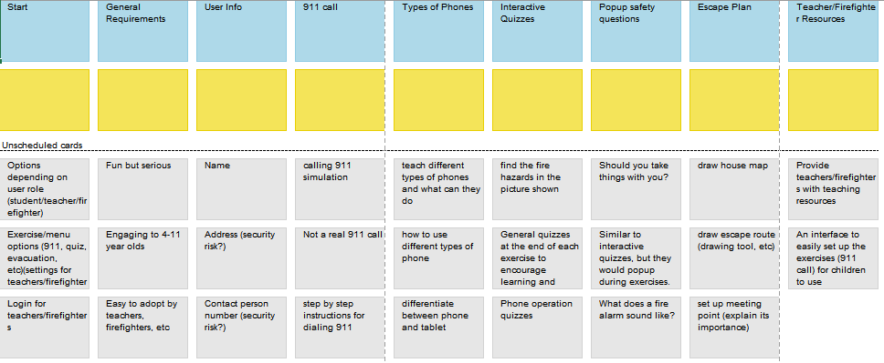
Empathy & Affinity Mapping

Slide 4
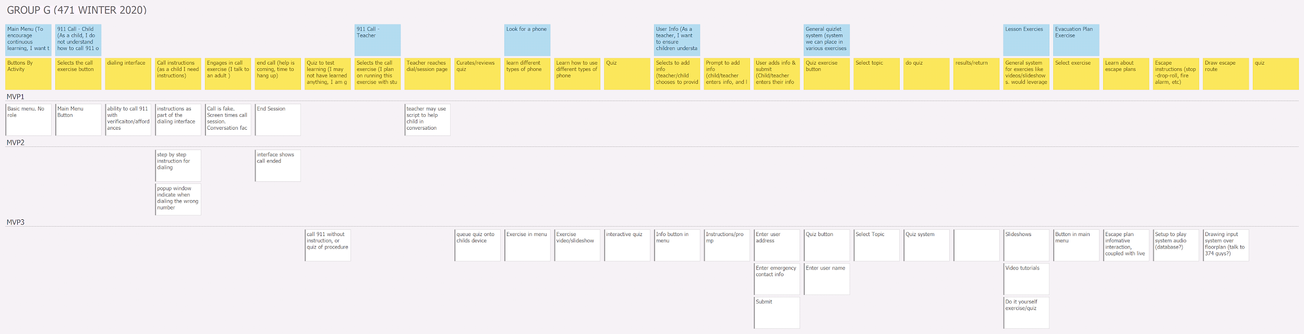
USM
Updated since last meeting - no longer aiming to support VOIP.
We were focussing too much on the technology.

Slide 5
USM
We did not delve into mvp 4 content, including quizzes

Slide 6
Lo-Fi

Slide 7
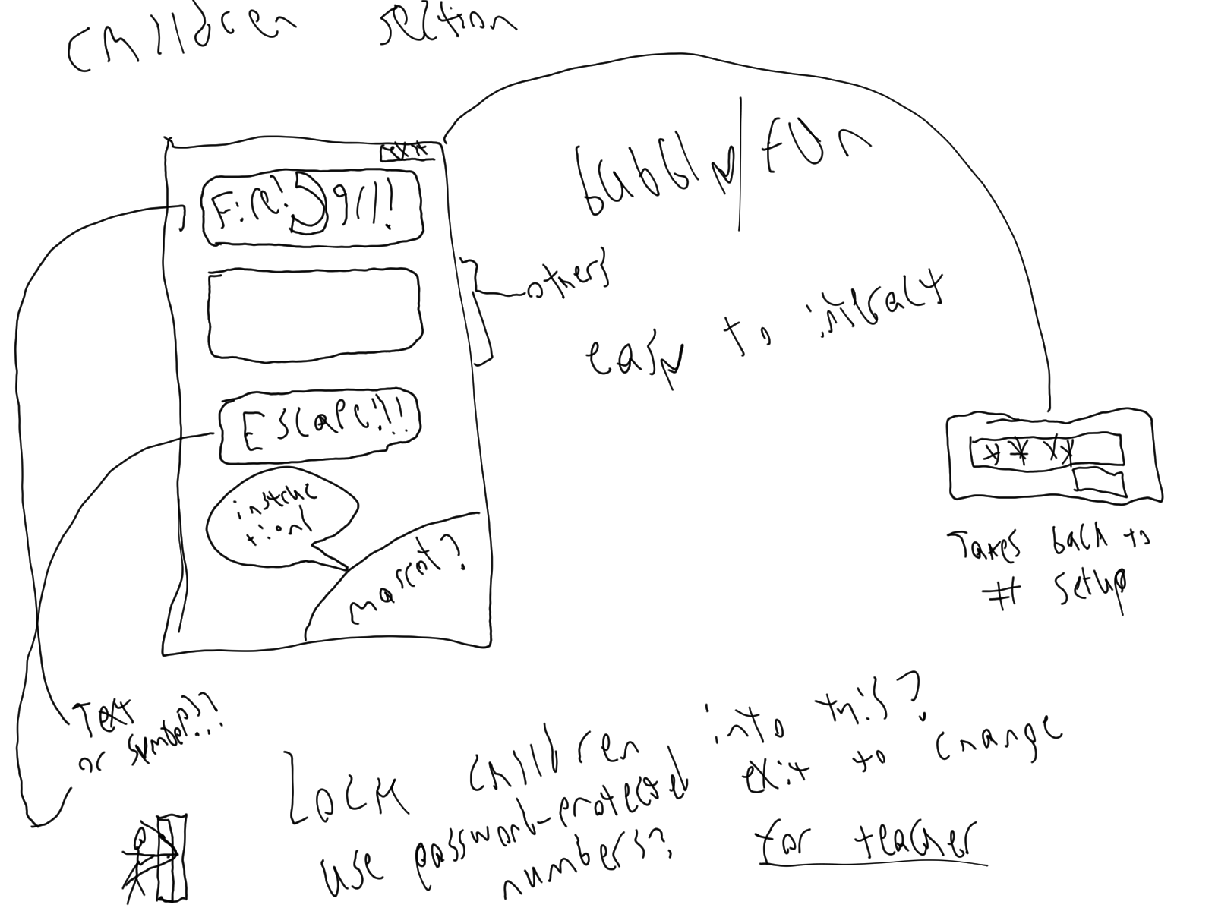
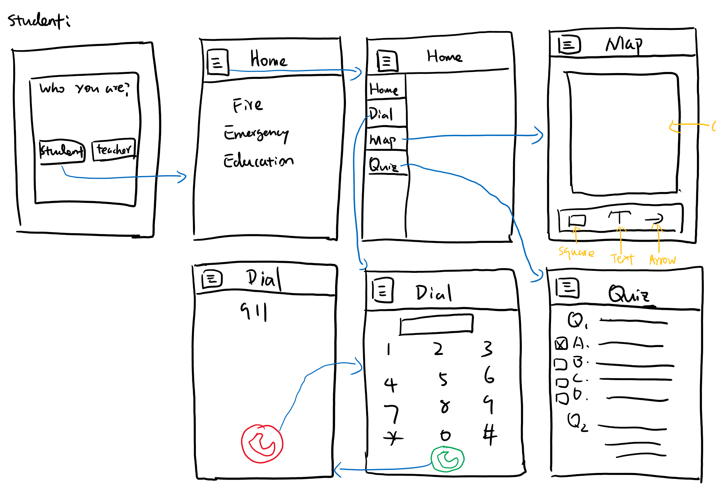
Notes:
For the lo-fi prototypes, we all come up different designs but the key functions are the same: Dialing, escape map and quizzes.
the designs all starts from a main menu. Some of the prototypes starts from list all the functionalities like dialing, escape map, instruction
and others starts from a role based access page then go to function selection page respectively.
we all have the same design on the mock-up dialing page which should be exactly the same as the real phone dialing page.

Slide 8
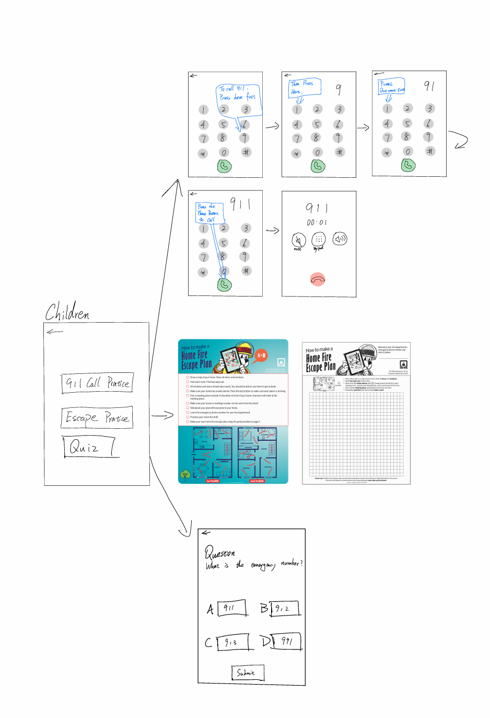
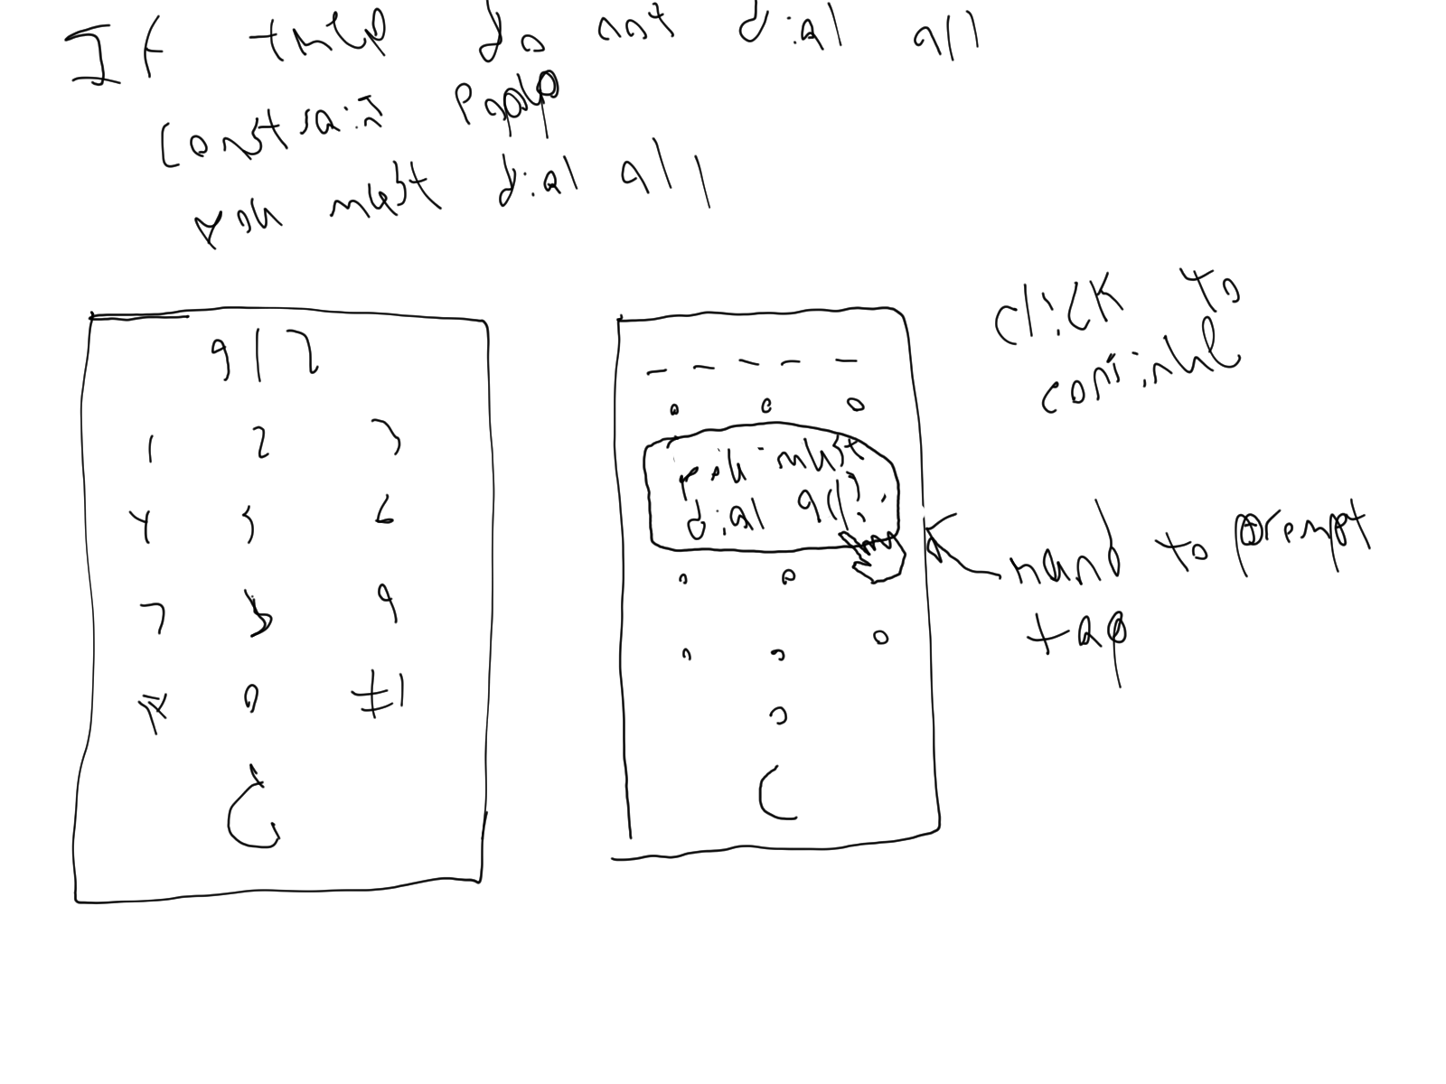
Notes:
some designs have pop-up windows as hints when children fail to call 911 and
the escape map looks like a canvas so that children can draw their home.
the quizzes are designed to be multiple choice questions after the education session.

Slide 9
Hi-Fi

Slide 10
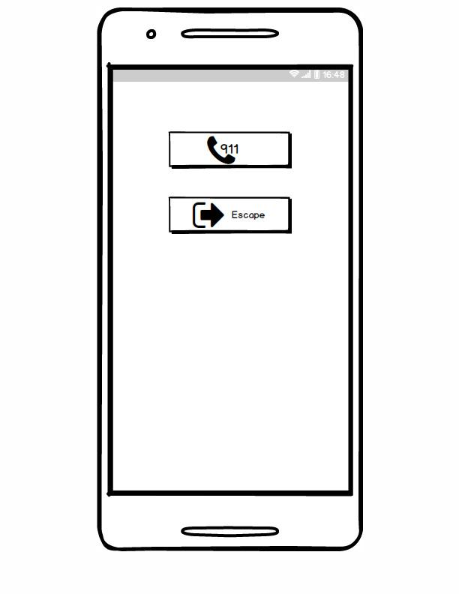
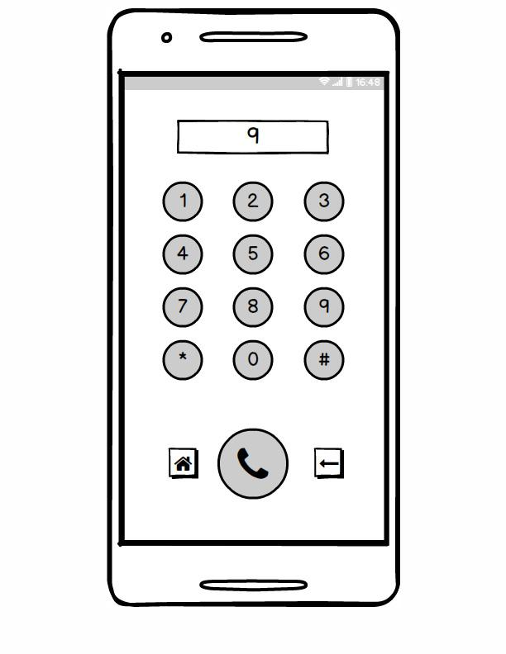
Familiar symbols used as signifiers, affording information that this will be used for calling 911 or escape activities.
Looks too much like a back button. Needs to look like a delete/backspace
Home button goes back to main menu, but is discrete and does not draw attention. Maintains form of the phone illusion. Discourages children from pressing it

Slide 11
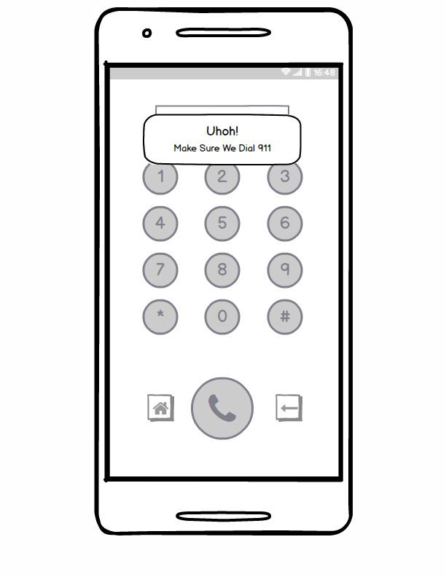
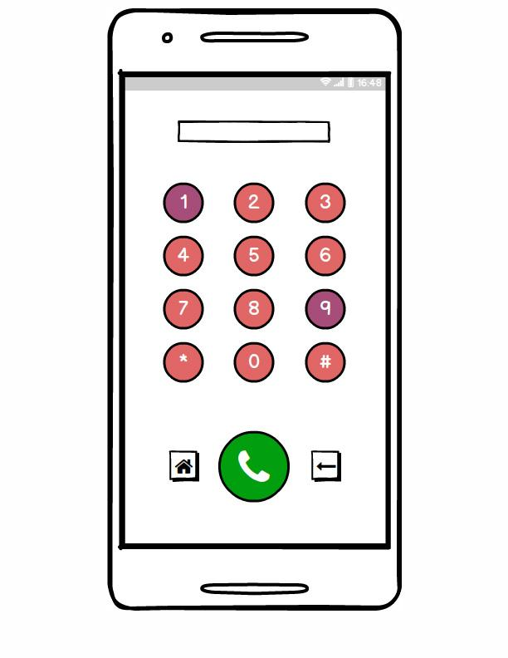
Colored buttons to encourage child’s actions.
Note, Candice does not want this to be the start. She wants the children to have their own chance without help.
A popup shows that something undesired, like dialing 911, has happened. The popup is auxiliary, and informs the child/teacher that they are no longer engaging with the number pad. This lets us take the user away, to say something important, without redirecting.

Slide 12
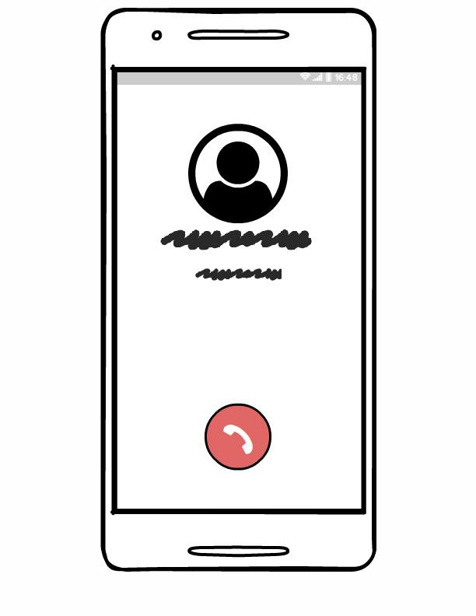
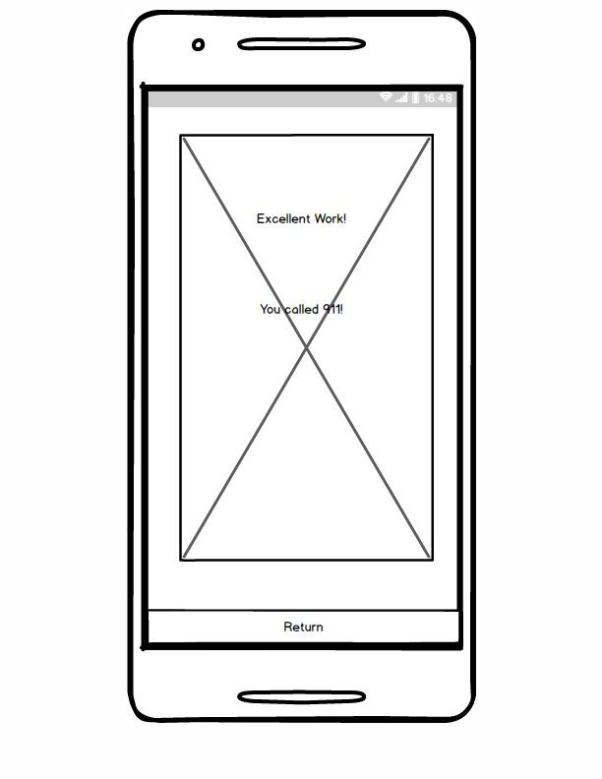
We maintain the illusion of a call
Child hangs up, and is finally taken out of the illusion for a congratulatory page.

Slide 13
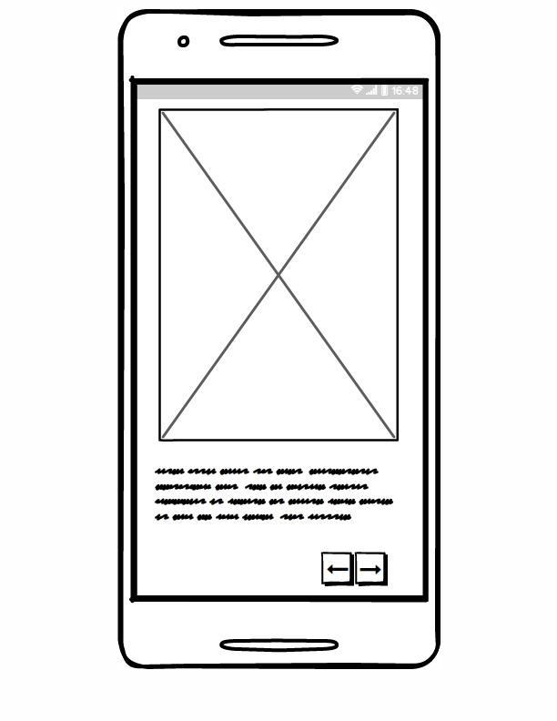
We also designed this instruction page when children could not dial 911 properly.

Slide 14
Solution Demo
Demo

Slide 15
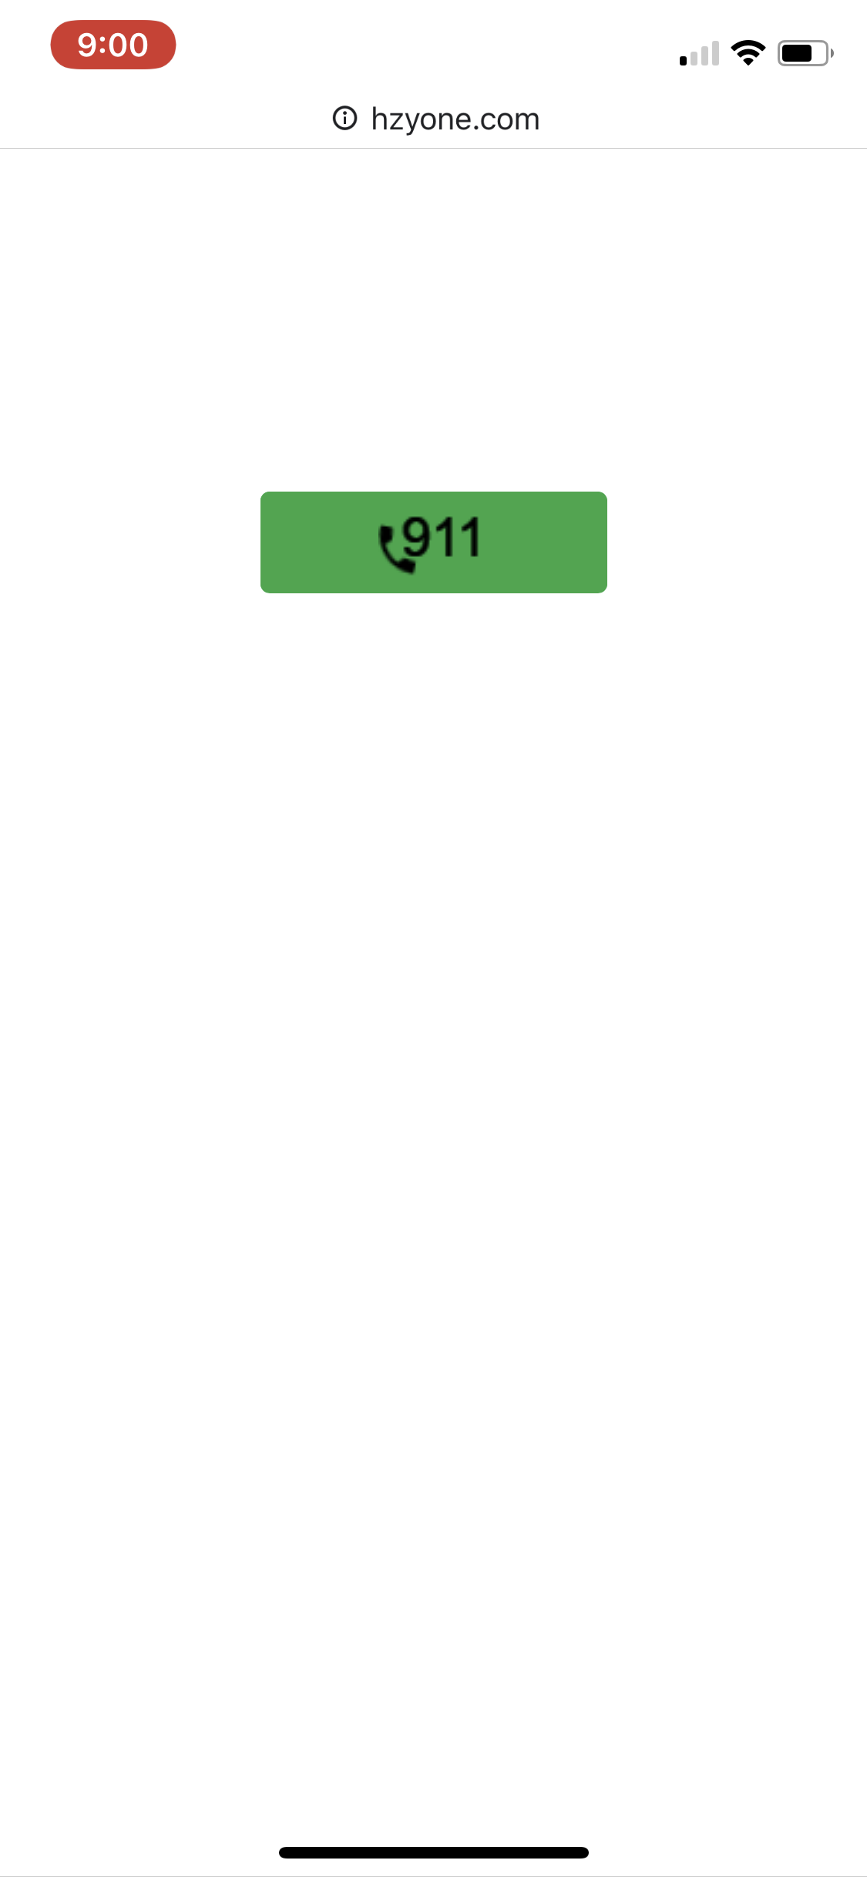
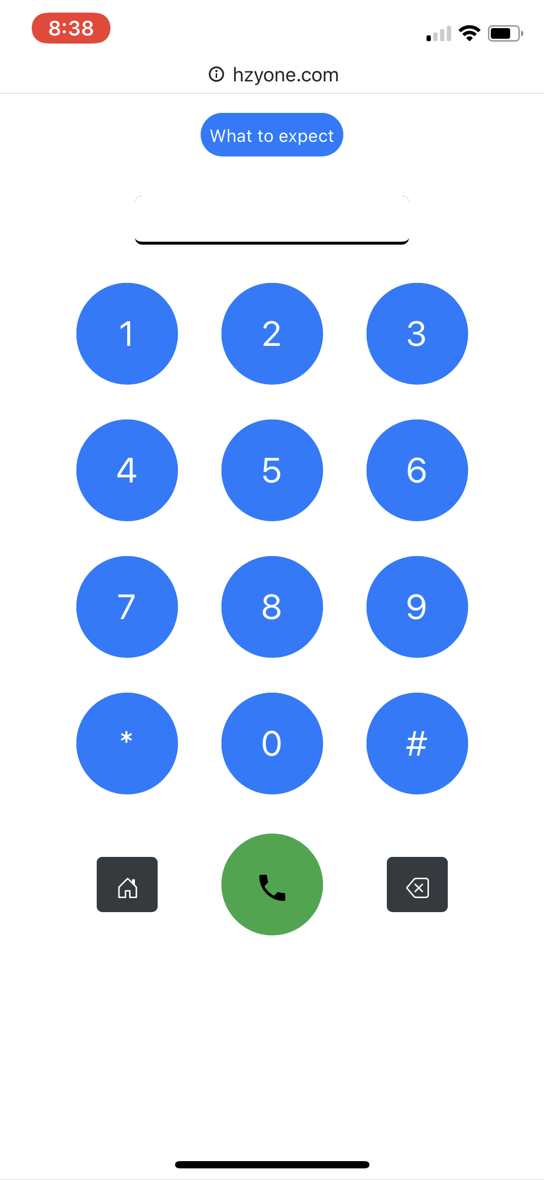
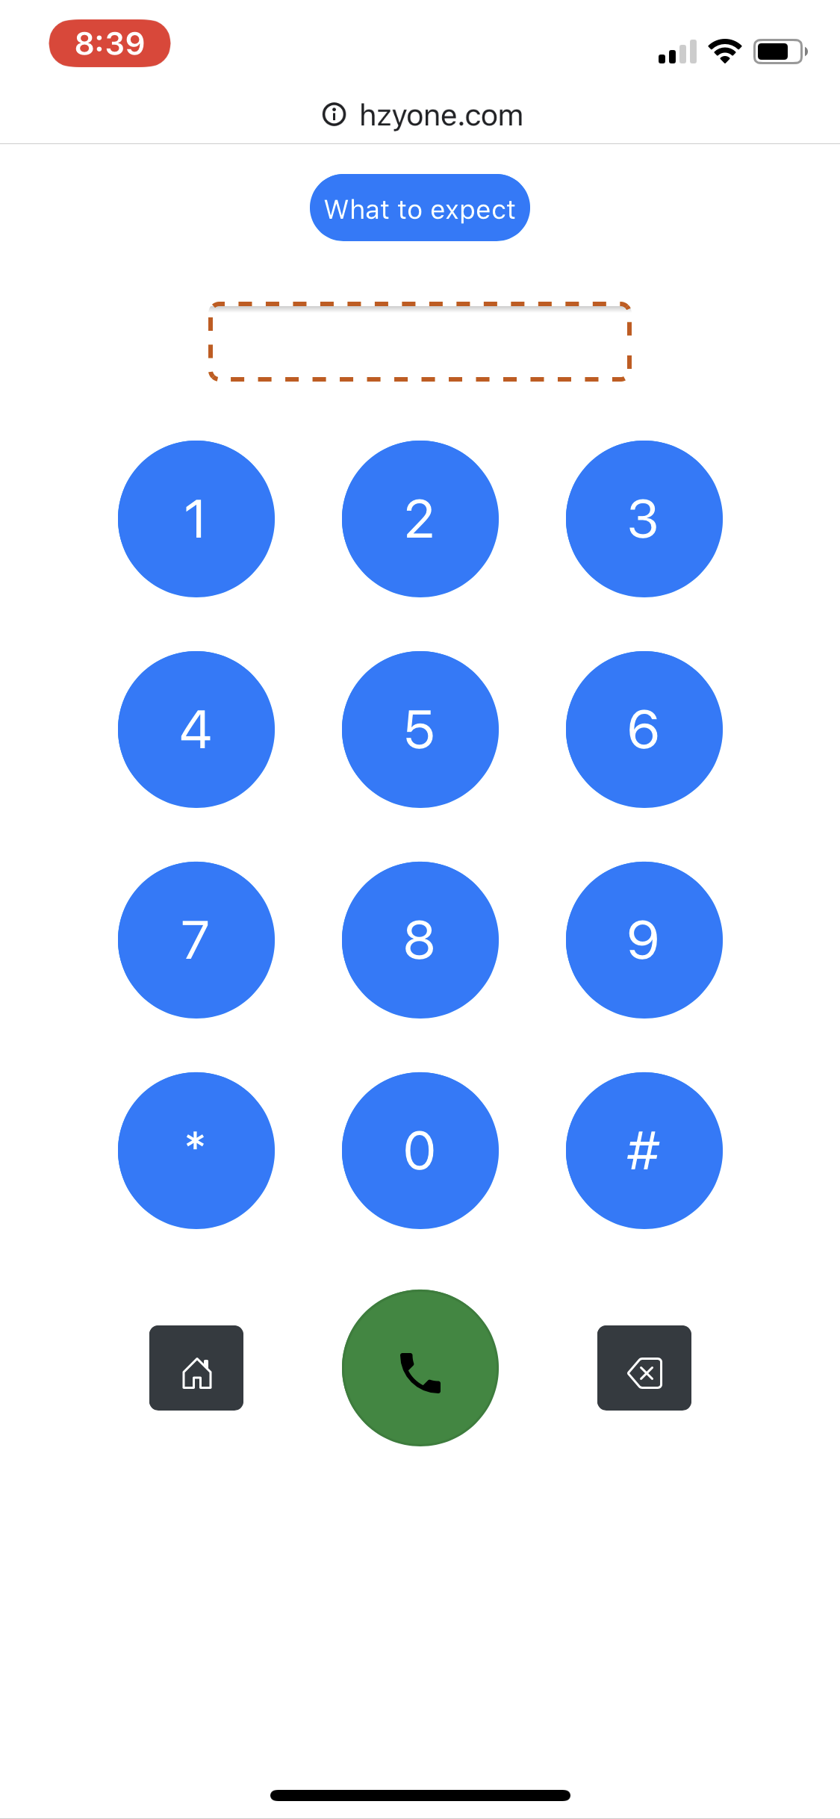
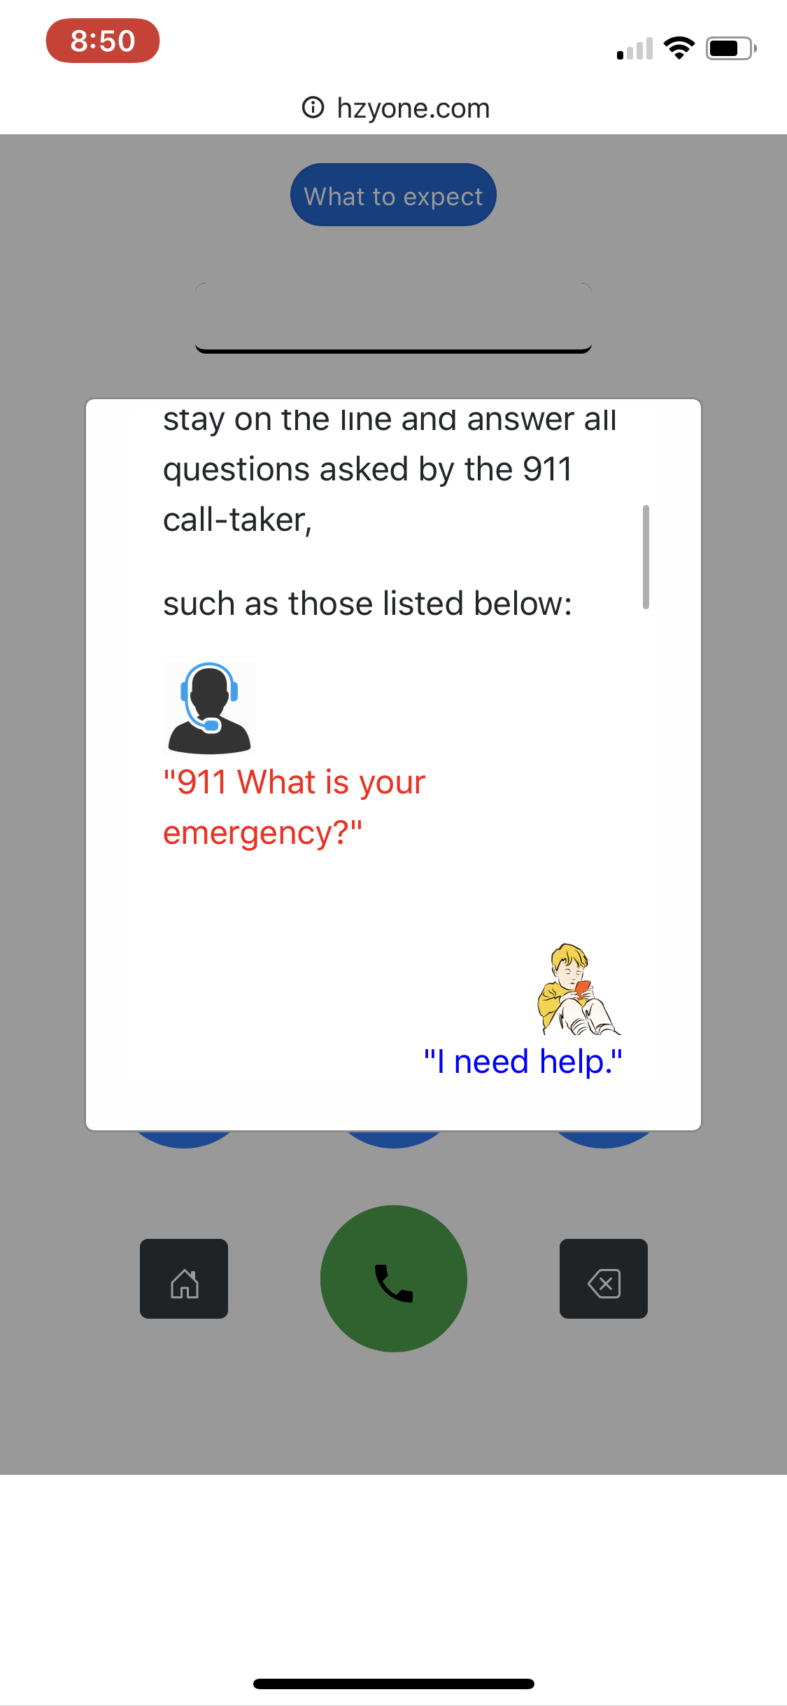
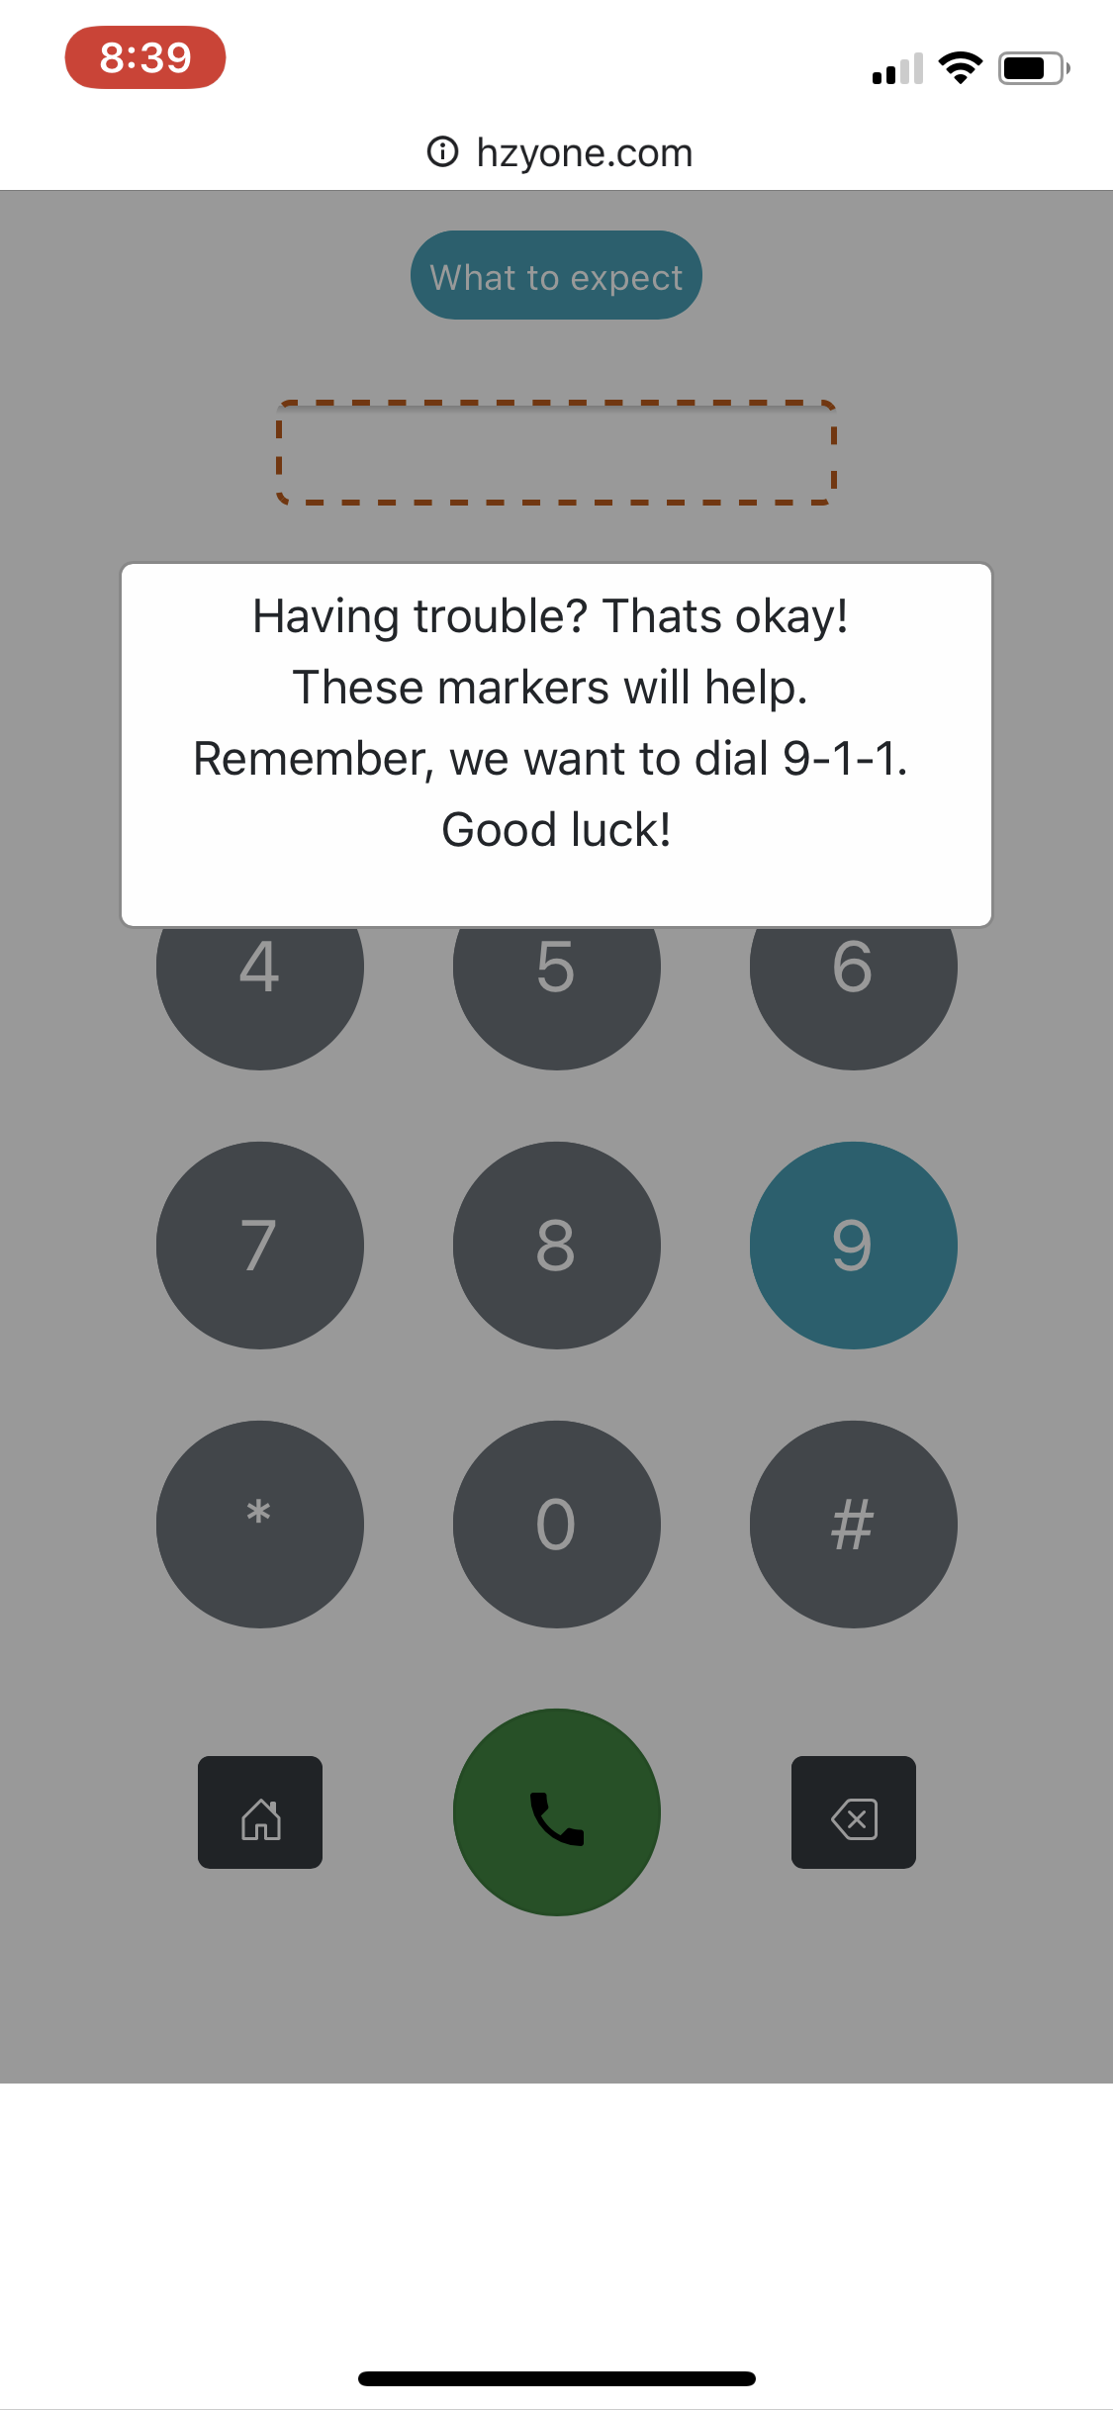
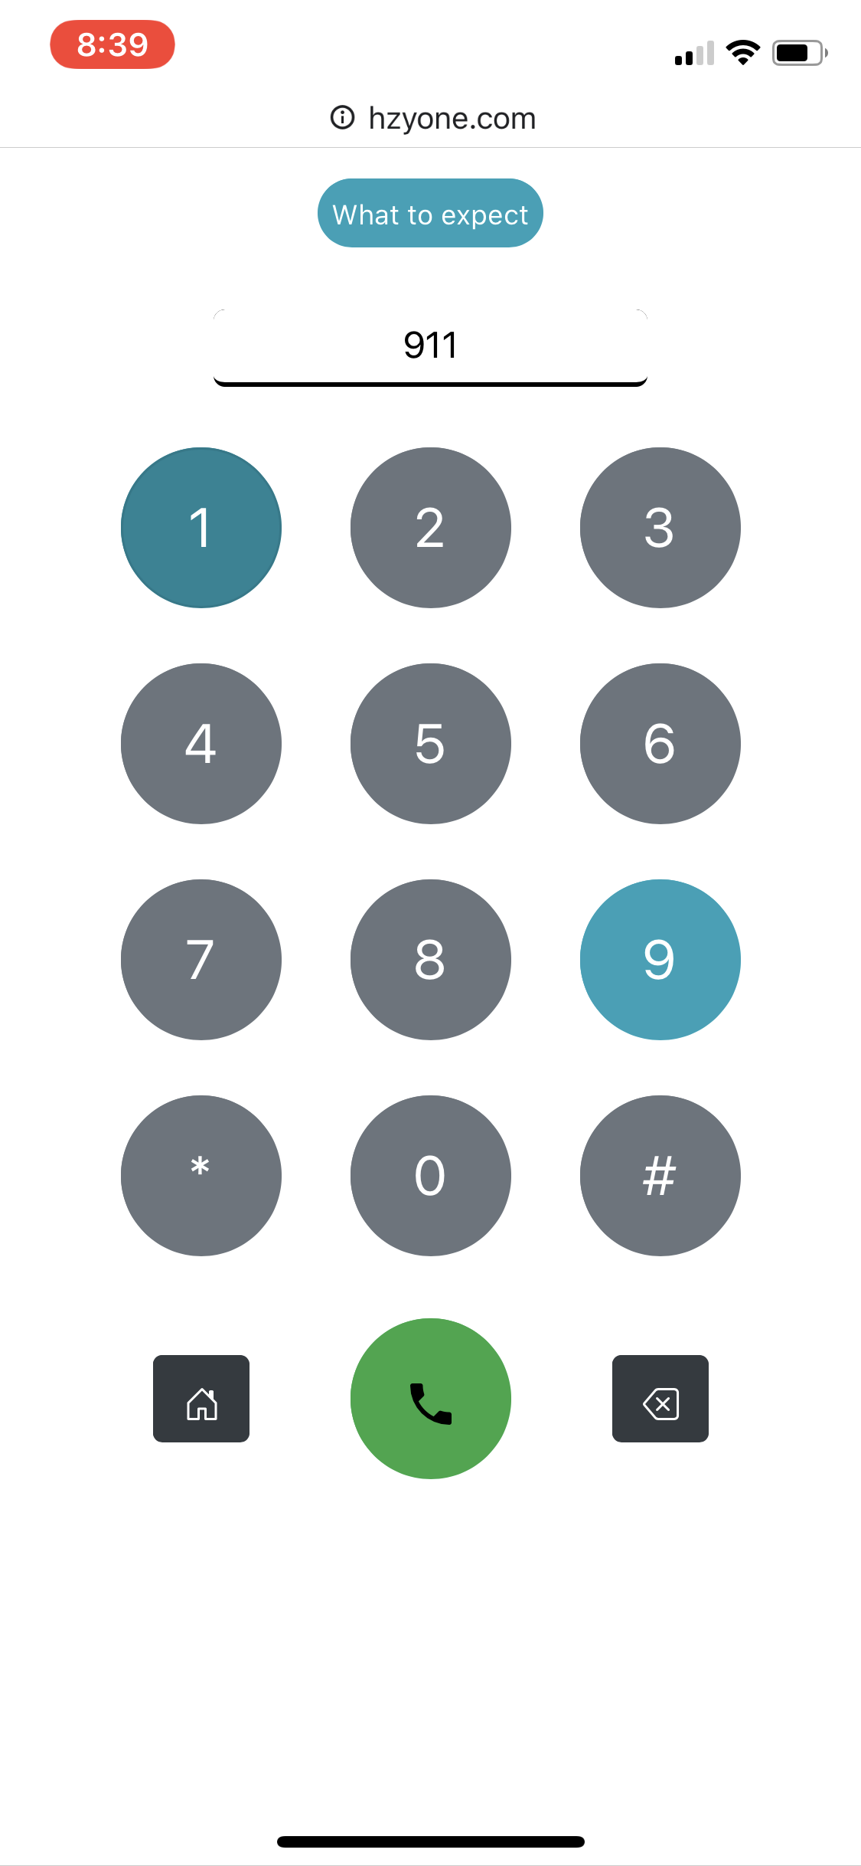
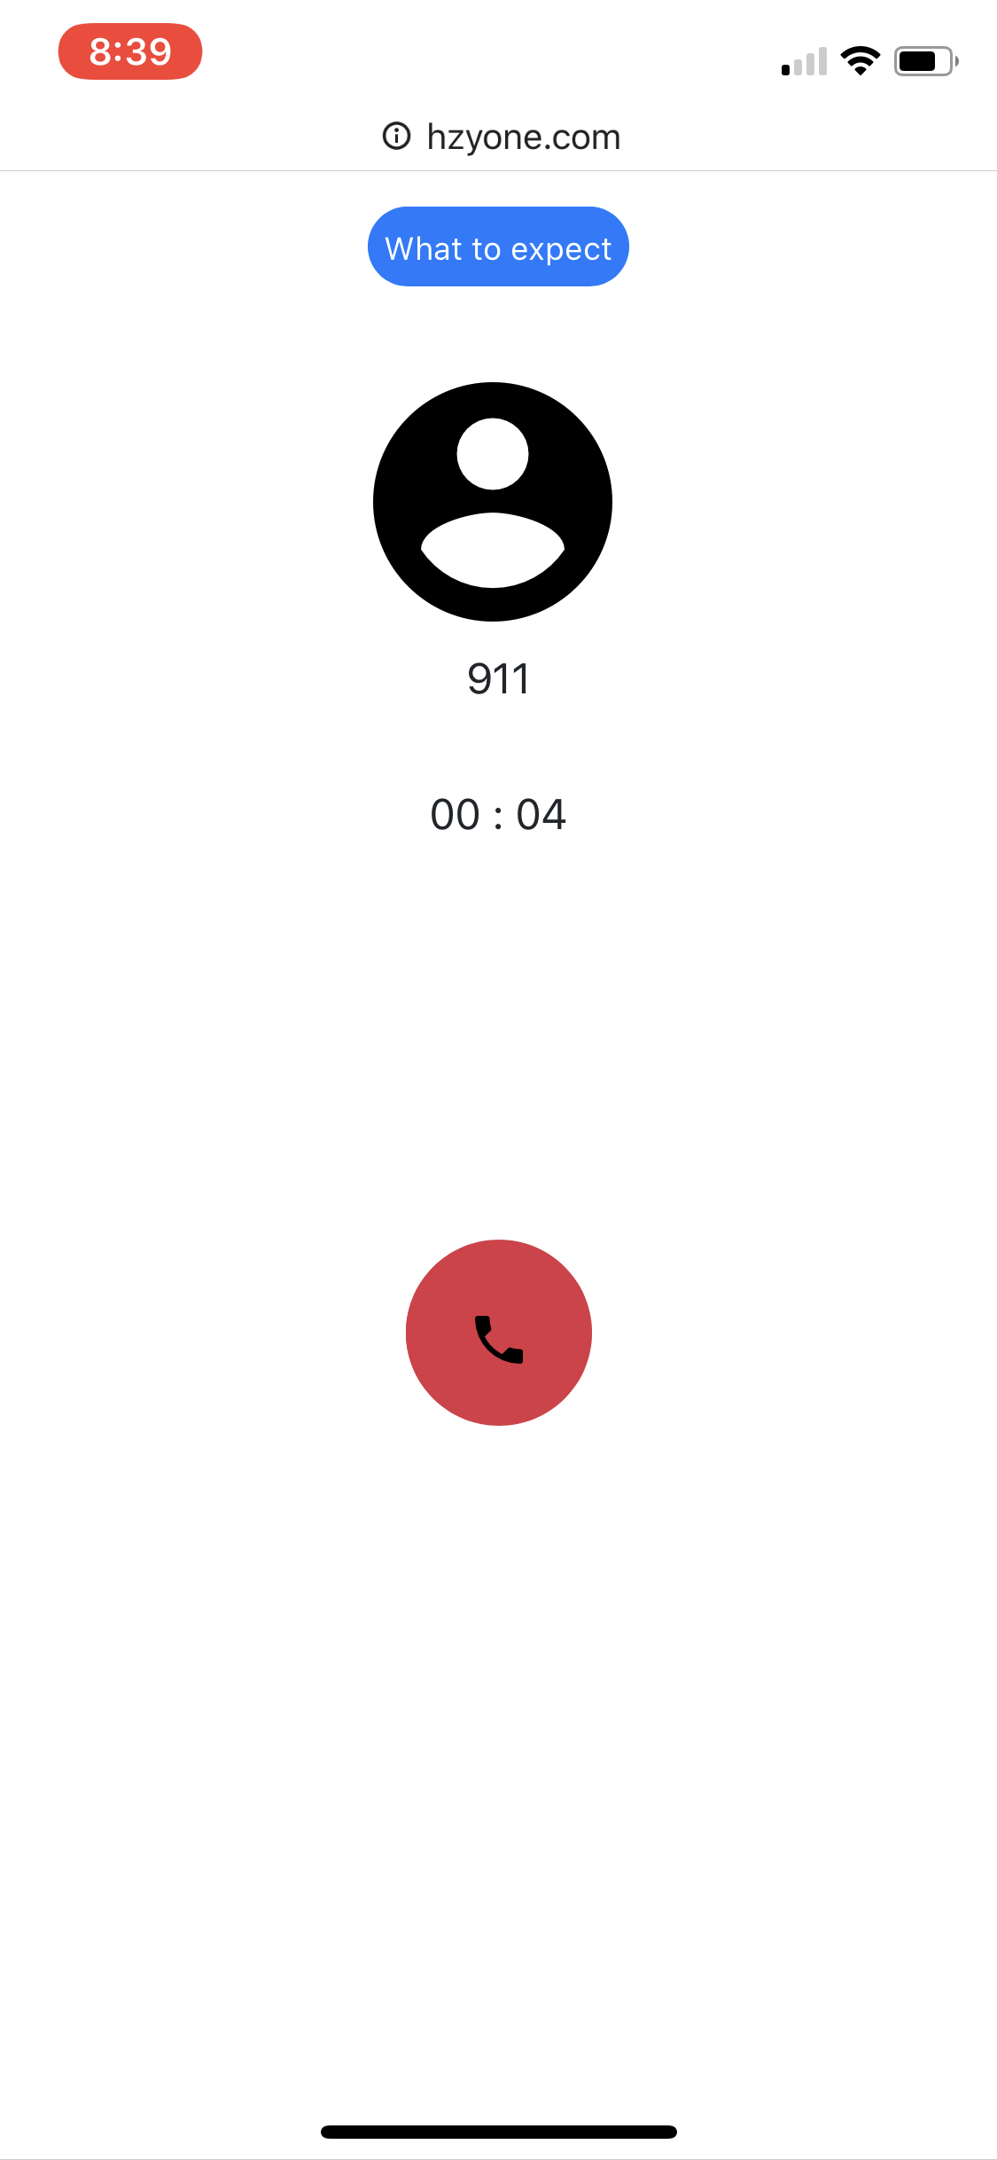
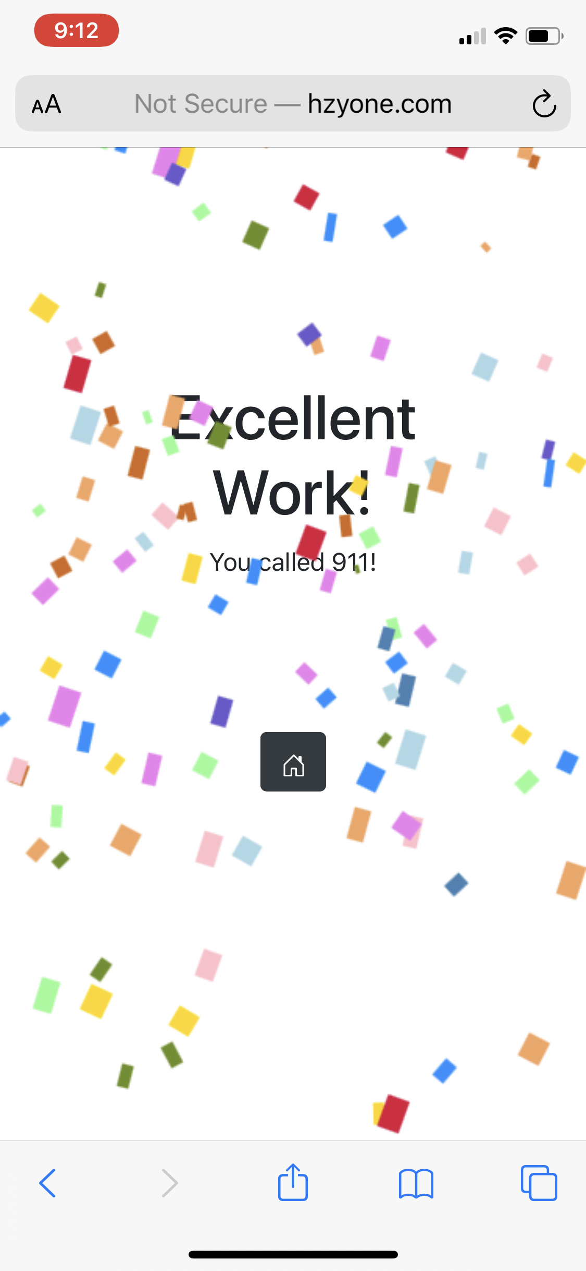
Screenshots: Affordability, Signifiers & Constraints
We used the design of our interface to do away with a teacher section. Which is much cleaner than providing two options before reaching the main menu
Input jiggles with a red outline to signify error. Child cannot continue until correct.
The intent of this modal is similar, but the content foreshadows future activity elements.
Blue buttons for importance.
Home is discrete
We use many affordances and signifiers to communicate what we had originally planned to say via slideshow
Confetti signifies job done, and done well. Encourages the child to celebrate and quit or pass on the phone.
This modal takes the child away from the sim without breaking the simulation’s form/progress.
Buttons gray out to discourage. Will later be disabled if failure persists.

Slide 16
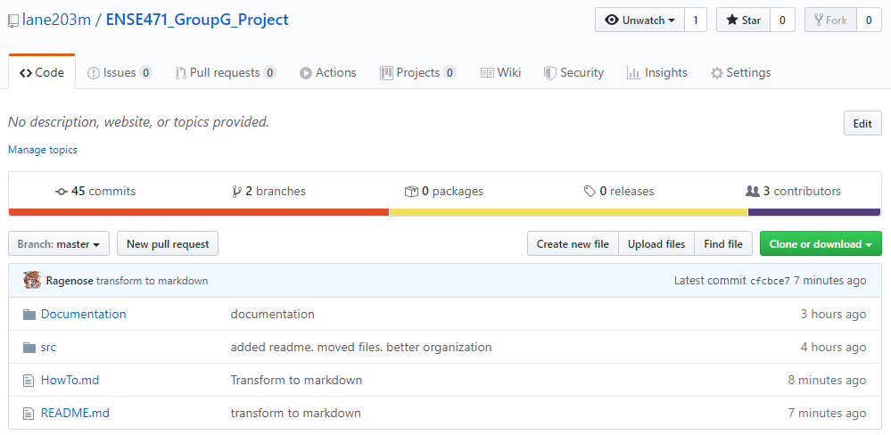
GitHub “stamp of approval”
https://github.com/lane203m/ENSE471_GroupG_Project

Slide 17
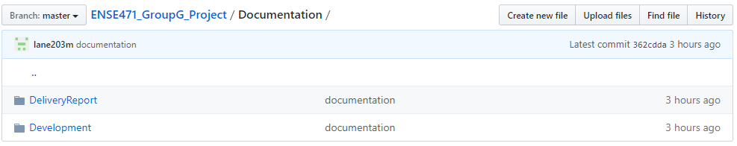
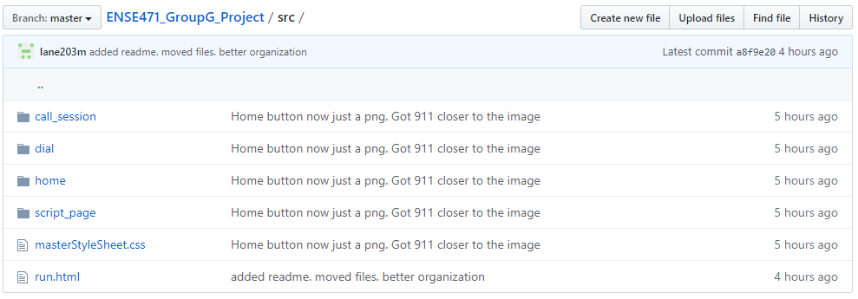

Slide 18
Group reflection
How did you feel about this project? What did you like about it? What did you dislike?
Challenging especially under current circumstance. Time constraints, and design changed radically
Feedback helped us realign our project’s vision/direction sooner.
What did you learn about yourself as you collaborated and worked through this project?
Collaboration brings more ideas, a picture is worth a 1000 words.
Don't rush into the technology.
How will you use what you have learned on this project going forward?
Design thinking process
People center design
Signifiers/affordances not only look better, but save time
Design first, not technology.

